Slide 1
FY2023 Revised Budget Proposal
Salem School Committee
Finance Subcommittee
May 9, 2022

Slide 2
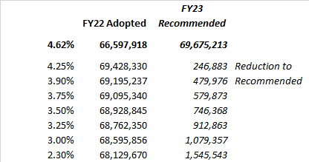
What is the amount at each level of reduction?
Finance Subcommittee requests administration to evaluate reductions from 4.6% to 3.0%.
Look for innovative solutions that minimize impact on students, staff, and schools.

Slide 3
Recommendation: Utilize existing operational resources to fund next year obligations where legally permitted
Sources of operational resources
Existing unspent balances in FY2022 supply and material accounts
Turnover savings and unfilled FY2022 positions
Unspent, unobligated special education tuition
Considerations
Prepay of FY2023 special education tuition as allowed under MGL
Create a special education tuition stabilization fund
Shift unspent FY2022 tuition to the stabilization fund in the event the reduction in FY2023 unanticipated tuition results in a budget shortfall

Slide 4
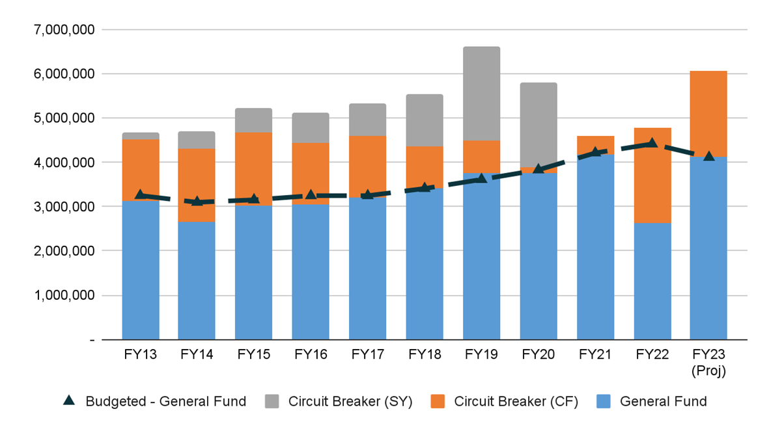
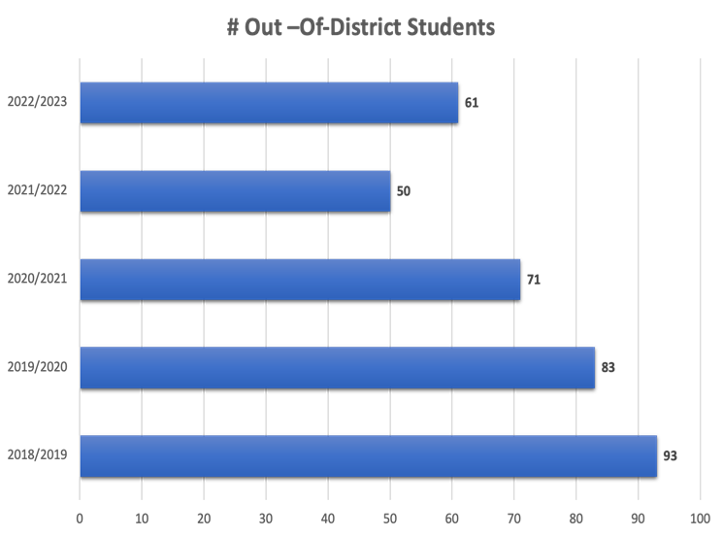
Historical Special Education Tuition Expense – All Funding Sources

Slide 5
Recommendation Details
FY22 Adopted Budget 66,597,918
FY23 Recommended Budget 69,675,213 3,077,295 4.62%
Additional State Aid (150,000) 69,525,213 4.40%
Additional Offsets to FY23 Budget
Pre-Pay Special Education Funds with FY22 Funds (550,000) 68,975,213 3.57%
Reduce FY23 Unanticipated Tuitions (1) (300,000) 68,715,213 3.17%
Keep Daily Operations Manager Positions on ESSER (77,250) 68,597,963 3.00%
FY2023 Revised Budget 68,597,963 2,000,045 3.00%
(1) Utilize newly created SE Tuition Stabilization Fund if Needed
Cautionary note: It is generally not best practice to rely on prior year funding to offset future year budgets. This option is uniquely available to us given our current fiscal situation. In FY2024, a funding source will need to be identified to cover this $600K in tuitions that would be funded using FY22 monies, unless tuition decreases next year.

Slide 6
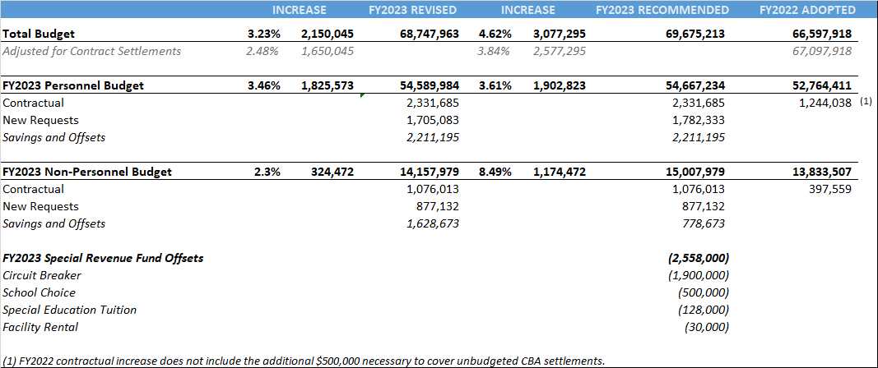
Revised Budget, Fiscal Year 2023
Note that increase in the FY2023 Revised budget appears overstated by $150,000 which is the additional Chapter 70 funding that is assumed to be used to offset the budget increase.

Slide 7
Reflections
Maintains integrity of initial proposal while working within city’s fiscal constraints
Does not resolve longstanding issues with Chapter 70- we must continue to ensure that Salem receive its fair share
Without additional state support, FY24 will be even more challenging
Conservative budgeting, circuit breaker and special education stabilization offer protection if there are unexpected special education costs in future budgets

